Slide 1
WIDERA
Widening participation and
Strengthening the European Research Area (ERA)
DANIELE GIZZI
15 May 2025
YEREVAN – ARMENIA

Slide 2
Widening participation and strengthening the European Research Area Infoday videos: https://www.youtube.com/watch?v=wdK-P91UtSo https://www.youtube.com/watch?v=rbuDOB_oukQ
HORIZON EUROPE

Slide 3
This part of the Horizon Europe Work Programme 2025 addresses the area “Widening participation and strengthening the European Research Area” (WIDERA).
The work programme includes two components:
I: Widening participation and spreading excellence;
II: Strengthening the European Research Area (ERA) by reforming and enhancing the European research and innovation system.

Slide 4
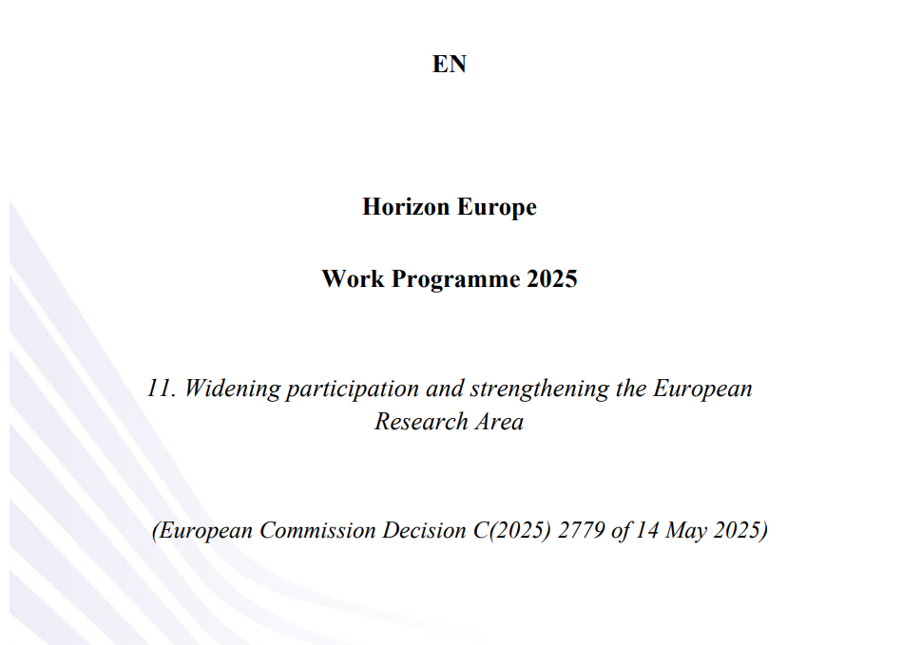
CALLS PUBLISHED ON 14 MAY 2025

Slide 5
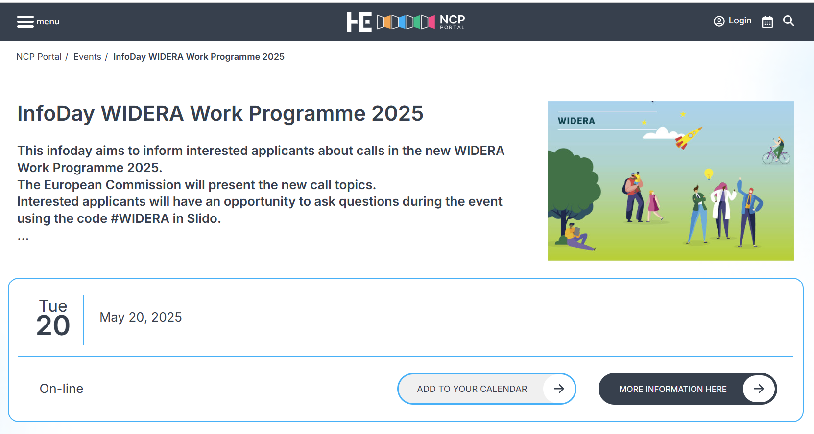
https://horizoneuropencpportal.eu/stage/infoday-widera-work-programme-2025

Slide 6
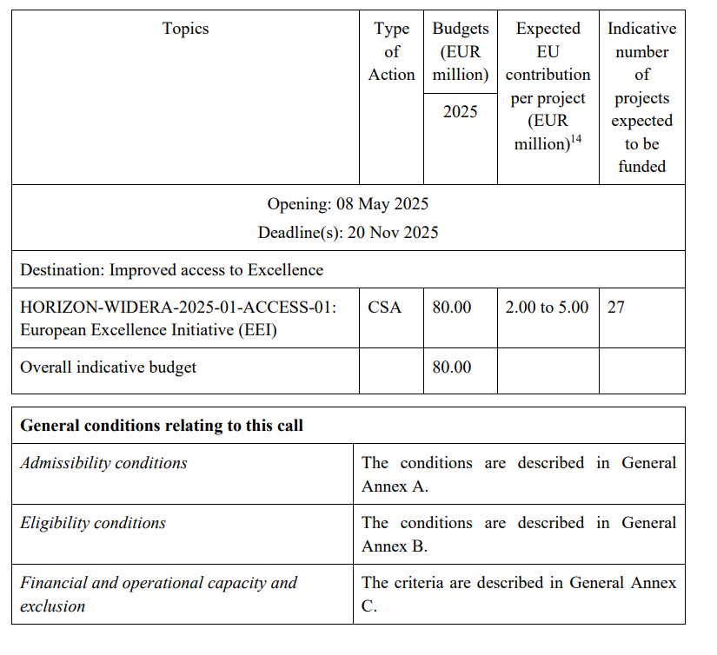

Slide 7
Thank you!
# HorizonEU
http://ec.europa.eu/horizon-europe

